Slide 1

Hamilton Street Railway Master Database
Saahil Karnik -Zaheeruddin Siddiqui
Karan Parmar -Abdul Mohsin Ahmed
Shrajna Shetty -Aman Khan

Slide 2

Outline
Hamilton Street Railway (HSR) is a public transport agency providing bus service in the Hamilton area.
We have designed a database that tracks the activity and operations of its bus fleet so they can analyze the utilization of buses and its resources in serving customers.

Slide 3

Executive Summary
We have designed the Hamilton Street Railway Master Database system, which has many robust and productive features.
Organized and stored individual data items in table format.
Displayed relationships / associations among entities as shown in Entity Relationship diagrams (ERDs).
Included details of physical data store organization including field name, field types, field size and other related metadata.
Exercised access and content controls, allowable values used for specific data items, list of users allowed to read or update data items via customized views.

Slide 4

Initial Phase to Design Phase
Collecting Requirements
Documentation of the most common concerns and expected features by collaborating with current customers and relevant stakeholders.
Conceptual Modelling
Cognitive perception of the data and its related processes by identifying entities, defining attributes, establishing relationships and business rules.
Logical Modelling
Clear pictorial representation of the data with all its child elements and high-level functionality. Primarily involved in designing the system with 4 core components which interact with each other resulting in child elements
Physical Database Design
ERD-based development of the database which comprises the table columns with involved relationships. Using these core and child entities, we normalized the flow of data and designed the Entity Relationship Diagram.

Slide 5

Business Rules
Event Information: Each event representing a closure or disruption in a specific route must have a unique identifier, name, description, start date and time, end date and time, and affected route(s) recorded.
Closure Events: Events representing closures or disruptions must specify the affected route(s) and the duration of the closure (start and end date and time).
Alternate Services: During closures, passengers must be informed about alternate routes, services or transportation options to minimize inconvenience.
Bus Information: Each bus must have a unique identifier, years in operation, number of seats, manufacturer, advertising revenue, and fuel type recorded.
Route and Stop Information: Routes and stops must have unique identifiers and names. A route contains multiple stops, and a stop may belong to multiple routes.

Slide 6
Business Rules (Continued)
Recording Closure Reasons: The reason for the closure event (e.g., track maintenance, emergency repair) must be recorded for tracking and analysis purposes.
Coordination with Maintenance: Closure events may be initiated due to maintenance activities, and there must be coordination between maintenance personnel and operations staff to ensure timely completion of maintenance work and restoration of service
No Service during Closure: During the duration of a closure event, no buses will operate on the affected route(s).
Communication of Closure: Closure events must be communicated to passengers through appropriate channels (e.g., website, mobile app, signage at stops) to inform them about service disruptions.
Sites must have their name, address, phone number, capacity, and category recorded.
6

Slide 7
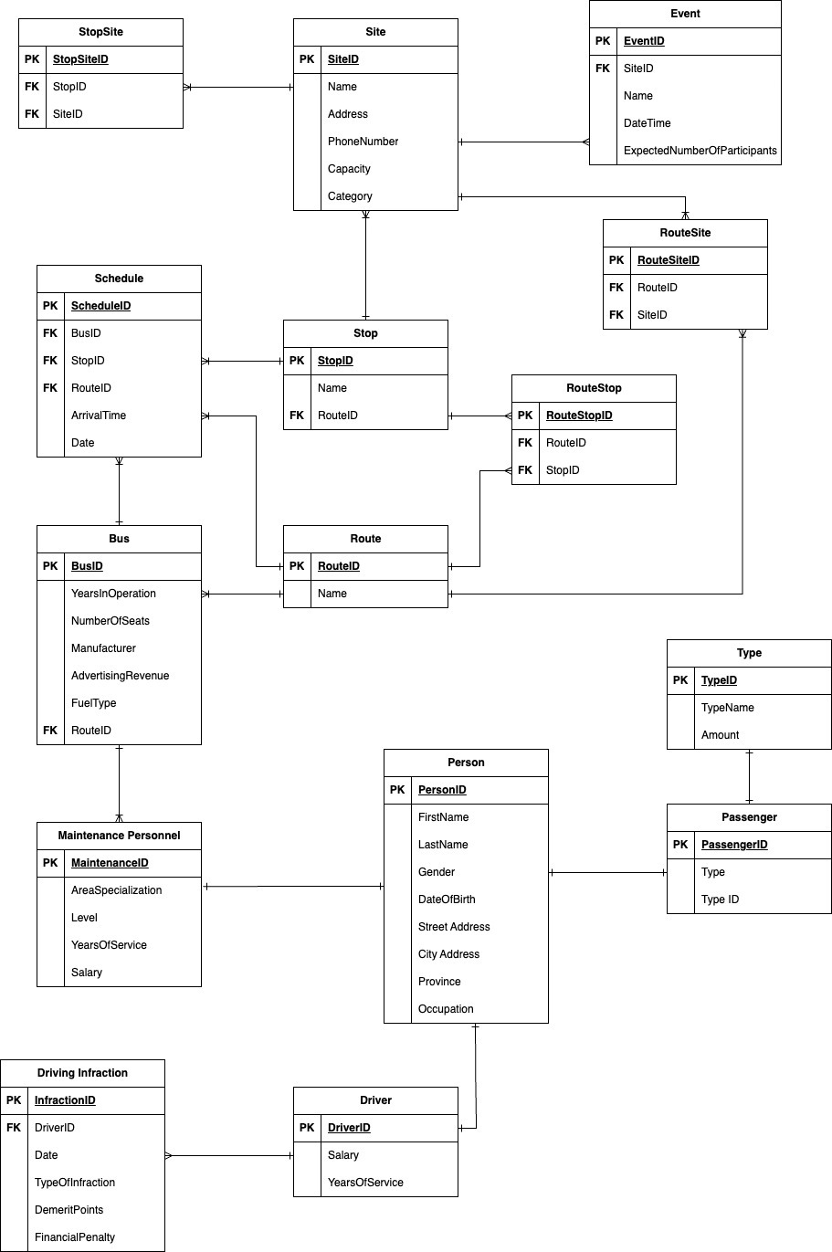
ERD (Original)

Slide 8
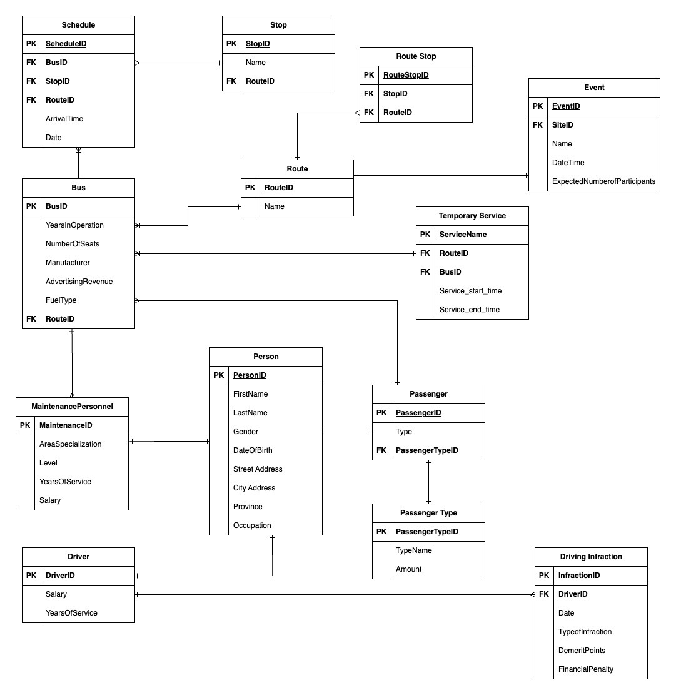
ERD (Updated)

Slide 9
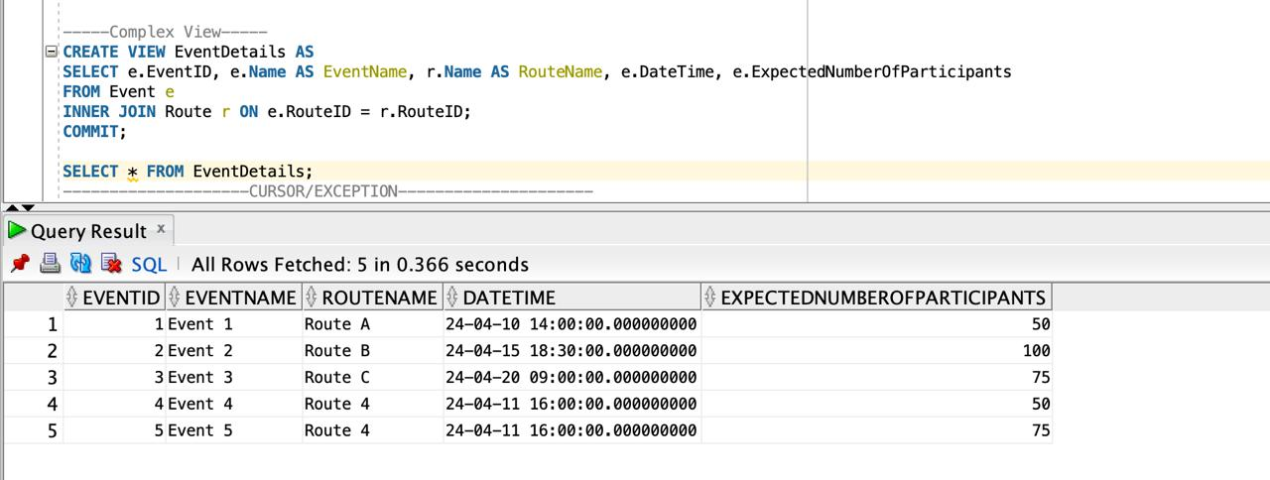
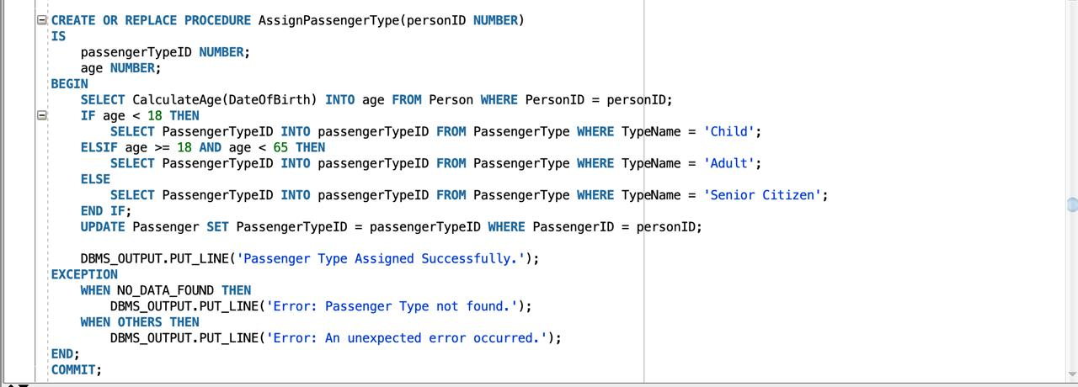
Code
Sequence
Views
Procedures

Slide 10
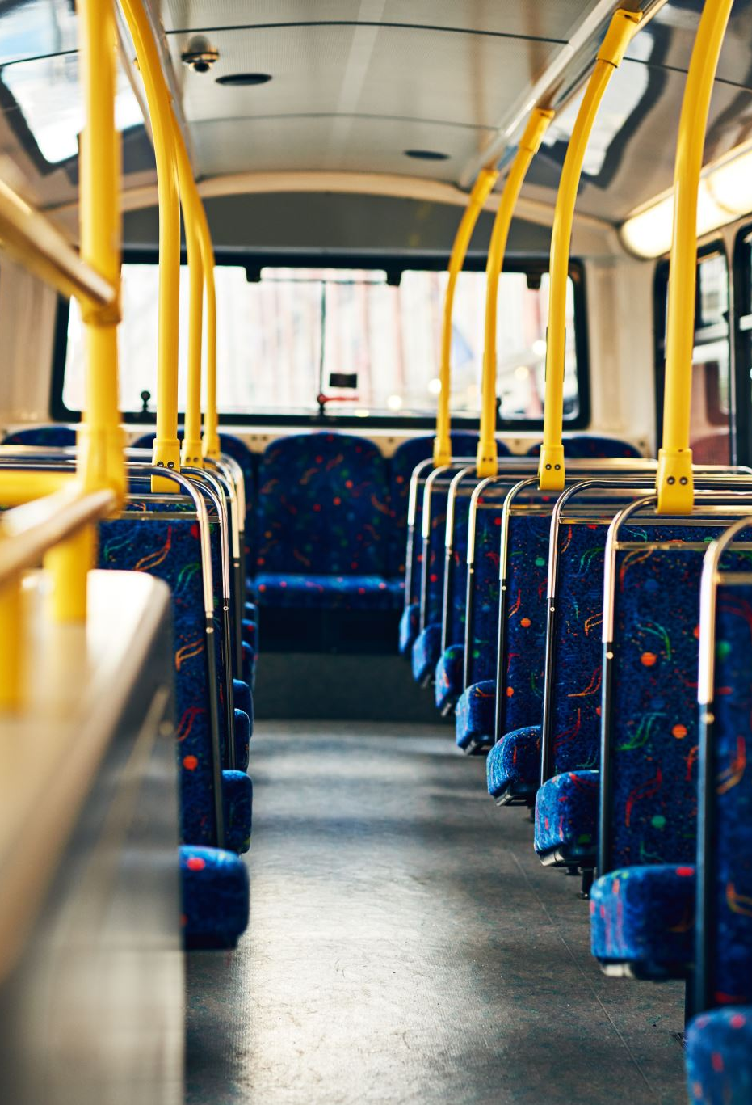
Physical Schema
The most important entities and their attributes are:
Person- Name, Gender, Date of birth, Address(Street/City/Province), Occupation. Maintenance Personnel, Passenger Type, Driver etc. are derived from Person.
Route- Route#, Name. Route Stop, and Event are derived from Route.
Bus- Years in Operation, No. Of Seats, Manufacturer, Route ID, Schedule, Stop, Service are derived from Bus.

Slide 11

Application
Any transit system can use this application to store the details of customers, routes, and vehicles used.
Aids the management to view snapshots of each significant entity and immediately root out problems.
Helps provide insights to efficiently manage company resources – vehicles, drivers.
Helps management to effectively chart out new routes and stops to maximize revenue and increase customer convenience.

Slide 12

Sales & Service Expansion
With the driver models and their respective infractions data, we get insights into trends of drivers committing traffic infractions. This aids in planning and preventing losses through fines and any other legal issues.
We can build new route and transit option for the future reference as per sales, supply and demand of the city population

Slide 13

Financial Gain
With this database, the requirements and concerns of the customers and the employees can be analyzed and easily addressed.
Such a comprehensive database with support for business intelligence tools will help the management maximize the resources available.
This assures increasing profitability.

Slide 14

Summary
So, with this intuitive master database, HSR would have the cutting-edge expertise to take smart business decisions.
It endears the customers and bus drivers.
It ensures that there are no data gaps and keeps track of all the processes involved in this.

Slide 15

Thank you

